Slide 1
Managing Churn using Customer Analytics
Bipin Karunakaran
Renaissance Learning

Slide 2

Mission Statement
www.renaissance.com
Clearly state your company’s long term mission. Try to use words that will help direct the growth of your company, but be as concise as possible.

Slide 3









Products
Practice
Assessment

Slide 4
About the company
Founded in 1986 by Judith & Terrence Paul around Accelerated Reader
Currently the leader in the Pre-K -12 Assessment & Practice software
Sells to Schools and School Districts
Sales force of ≈150 across the US
35 -40% market penetration in US
Growing presence internationally
Annual Subscription model, fee based on user count

Slide 5
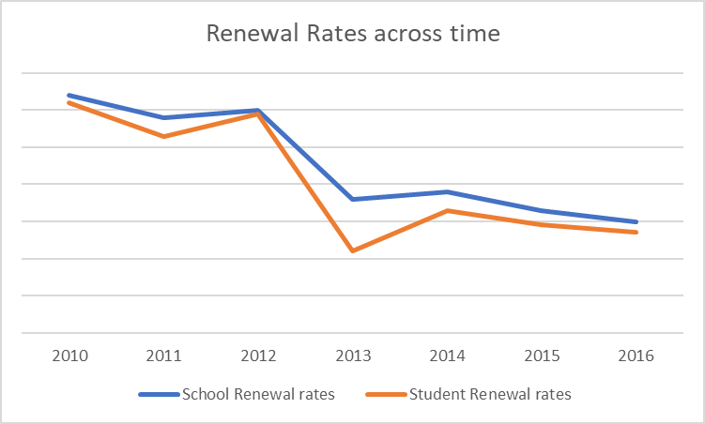
Renewal rates
School vs Student Renewals
Latter a function of the former
As business grows with expanded product and customer base, loyalty is the likely victim
Identifying the customer’s likely hood to churn is critical for planning timely interventions.

Slide 6
The Value of Retaining
Costs significantly high to acquire
Long term customers
Are likely to be loyal and become brand advocates
Present Opportunity for upsell and cross sell
Are more engaged and likely to provide feedback on products
Churn Management efforts are centered around identifying the customers who are at risk, and taking proactive action based on early warning signals

Slide 7
Factors that could influence churn
Price
Utility
Usage
Adoption
Benefiting from Use
Sales and Marketing touch points
Emails opens, clicks
Professional services usage
Webinars attended
Brand Loyalty
Tenure
Engagement with the company
District/School factors
Income levels
Funding
Technology Use

Slide 8
Should Price be a feature in churn model
Price Increases
Price does influence renewal rates
But should it be a predictor in the model?

Slide 9
Features for the churn model
Price
Utility
Usage frequency
Benefiting from Use
Sales and Marketing touch points
Emails, Calls
Professional services usage
Brand Loyalty
Tenure
Subscription to other products
District/School factors
Income levels
Funding
Technology Use

Slide 10
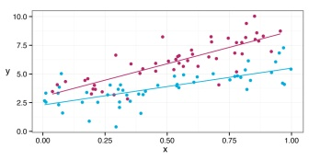

The Churn Model
Prediction Model
Churn Score (0 – 100 %)
Churn Prediction by Subscription Expiration Quarters
Interpretability is of paramount importance
Logistic regression model is being used
Deep learning, Random Forest and SVM were tried
Excluded schools covered under Govt contracts

Slide 11
Model Fitting
Oversampling needed due to target imbalance
Predicted probability will need adjustment
Preprocessing and N-fold cross validation
Example predictors that make into the model:
# of quizzes per student
# of grades using the product
Average Engaged Reading Time in minutes
% of students scoring > Threshold value
#of Apple Macs in the district
Customer Tenure
Average Household income in the district
Typical AUC of 78 to 82%
A model is trained for each product for each quarter.

Slide 12

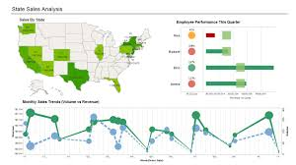





Deployment
Health Score Dashboards
Chron Jobs Executing R scripts
Server

Slide 13
Health Score and Mid Year Health Check
Customer Success Reps call at the middle of the subscription year
Health Score 1 had a statistically significant lift* in renewal rates by 8 – 10% for customers who were called
*Samples were controlled based on District sizes and other confounding factors

Slide 14
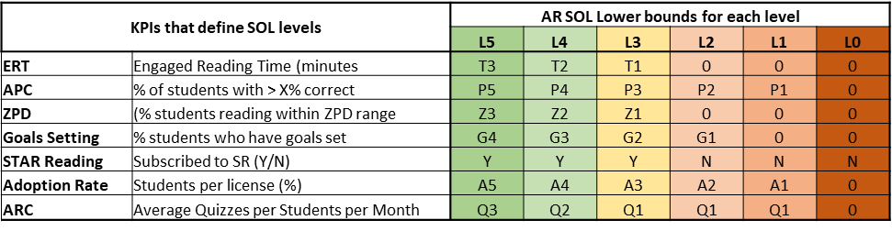
Product Usage Maturity Levels
Usage activity predictors overlaps with Recommended Best Practices for Improving Student Outcome
Maturity levels defined based on best practice utilization
Inversely correlates with churn score, but very effective for messaging to the customer.
Campaigns aimed at moving customers up the levels very effective in lifting the renewal rates
Note: Ti, Pi, Zi, Gi, Ai, Qi are threshold values to qualify for that level

Slide 15
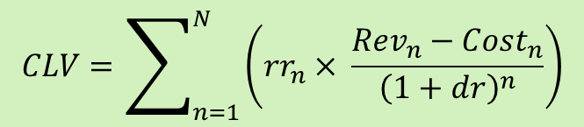
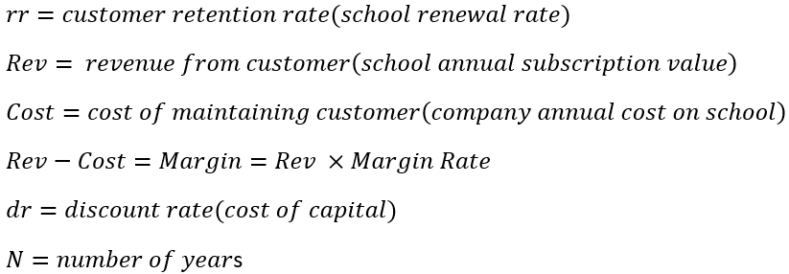
Prioritizing the outreach efforts based on ROI
Is risk the only factor to consider? What about the reward
Customer Life Time Value Segmentation is the key
CLTV: Net Present Value of potential future earnings

Slide 16
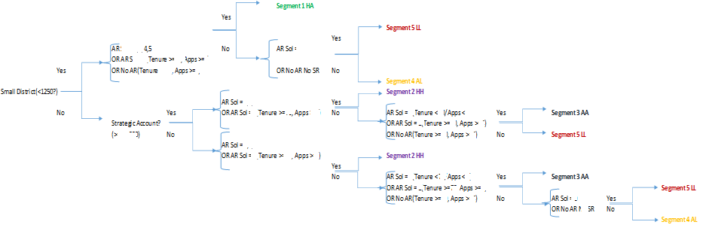
Segmenting by Rev & Renewal rates for CLTV
Segment customers using K-means on Subscription Value and Renewal Rates among other variables
Used Decision Tree to Find easily interpretable defining rules for each segment
Note: The segmentation variables/values are blanked

Slide 17
CLTV Segments
Note: All the numbers have been changed from actual, maintaining the same variance.

Slide 18
Risk vs Value
Test and Learn to identify the depth for optimal
High value
Low Risk
High value
High Risk
Low value
Low Risk
Low Value
High Risk
Value
(CLV Segments)
Risk
(Health Score)

Slide 19
Test, Learn & Iterate
Impact of various outreach programs by products, by segments
Effectiveness of channels by themselves and in combination
Each campaign means more data
Overlaying NPS (Net Promoter Score) against the segments and observe changes across campaigns
Explore Predict Analyze
Segment
Test outreach strategies/ Channels
Refine

Slide 20
Lessons Learned
The importance of getting buy-in from functional groups cannot be over emphasized
Historical analysis of renewals and campaigns, touch points
What if scenarios
Easy to use interactive dashboards demonstrating the impact of predictors on the renewals
Keep it simple, at least in the beginning
Seize any opportunity to demonstrate value, reaching out in all directions

Slide 21
Thank You!
Questions?

